Slide 1

Introduction to the Tax Verification System (TVS)
The Tax Verification System (TVS) is a modernized platform designed to streamline tax payment processes through the incorporation of QR code technology. This innovative system aims to enhance the efficiency and accuracy of tax verification, providing a seamless experience for both taxpayers and tax authorities. By leveraging QR codes, taxpayers can easily verify the authenticity of tax documents and ensure compliance with regulations, while tax authorities can efficiently process and verify tax payments.

Slide 2
Purpose and Benefits of the TVS
Efficiency in Tax Processing
Enhanced Transparency
The TVS aims to streamline tax payment processes, reducing paperwork and manual input. This improves the overall efficiency of tax verification and payment, saving time for both taxpayers and tax authorities.
By incorporating QR code technology, the TVS enhances transparency in tax verification. It provides a clear trail of payment and verification, reducing the likelihood of fraud and ensuring a secure and transparent tax payment ecosystem.
User-Friendly Interface
Real-Time Verification
The TVS offers a user-friendly interface for taxpayers, making it easier for them to verify and make tax payments. This simplicity encourages compliance and reduces errors, ultimately leading to a smoother and more user-friendly experience.
One of the key benefits of the TVS is real-time verification. Taxpayers can instantly verify the status of their payments, ensuring peace of mind and timely rectification of any discrepancies, if present.

Slide 3
HARDWARE and SOFTWARE REQUIREMENT
Hardware:
1. Processor: Intel Core i3 or more.
2. RAM: 4GB or more.
3. Hard disk: 250 GB or more.
Software:
1. Operating System : Windows 10, 7, 8.
2. Java, Spring Boot.
3. Eclipse.
4. Visual studio code.
5. MYSQL, SQL Yog.

Slide 4
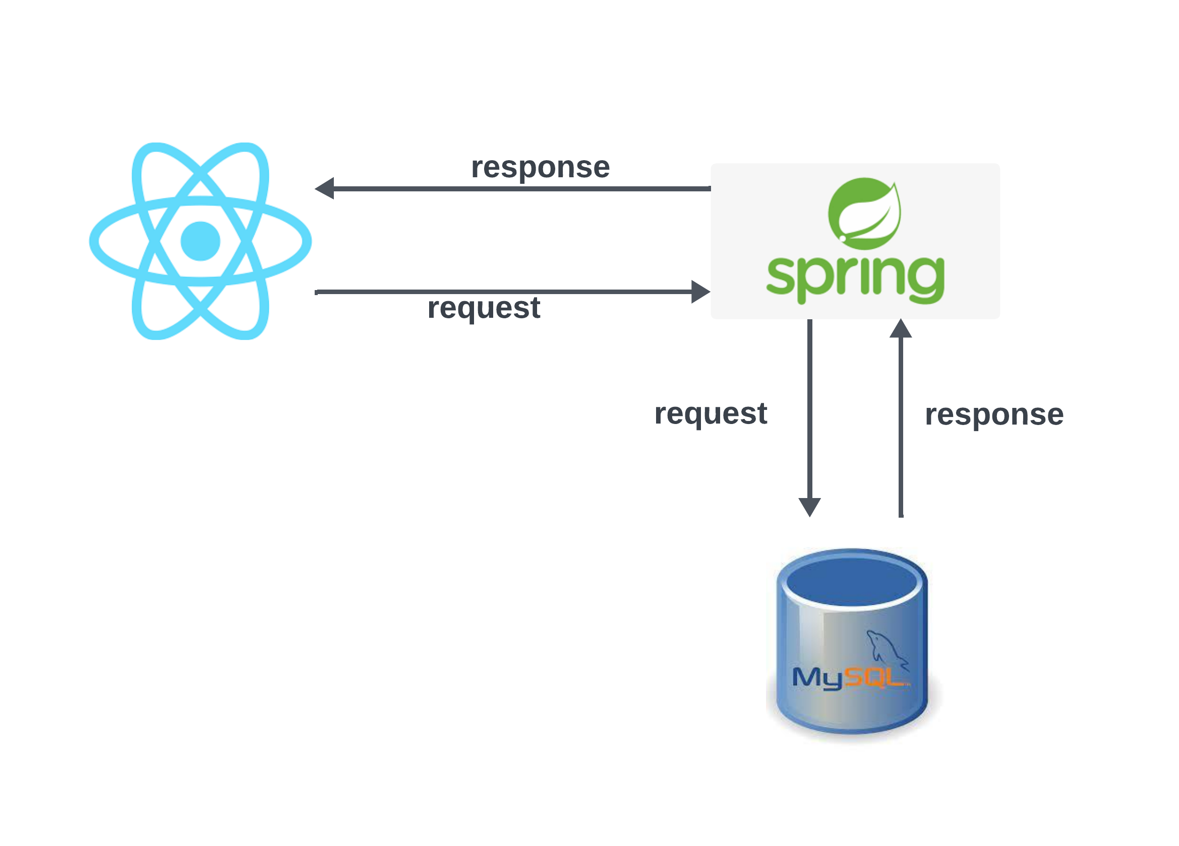
Technologies Used in the Project

Slide 5
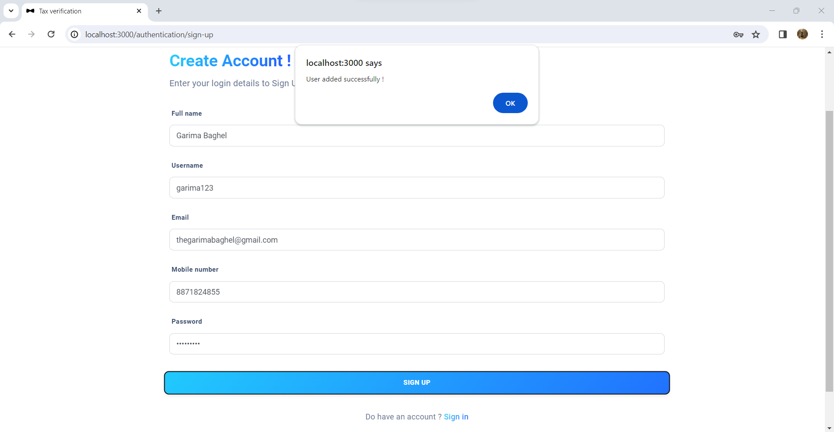
SIGN UP LAYOUT

Slide 6
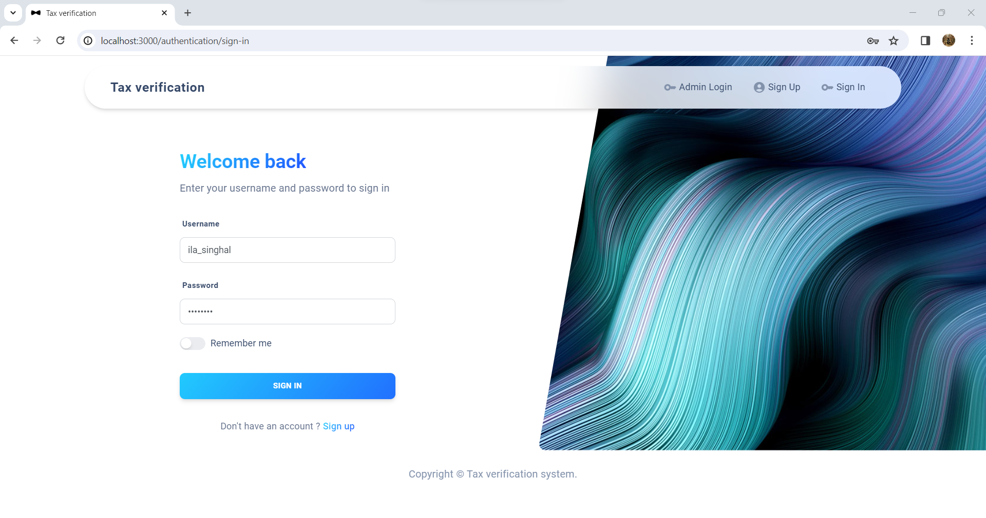
USER LOGIN PAGE

Slide 7
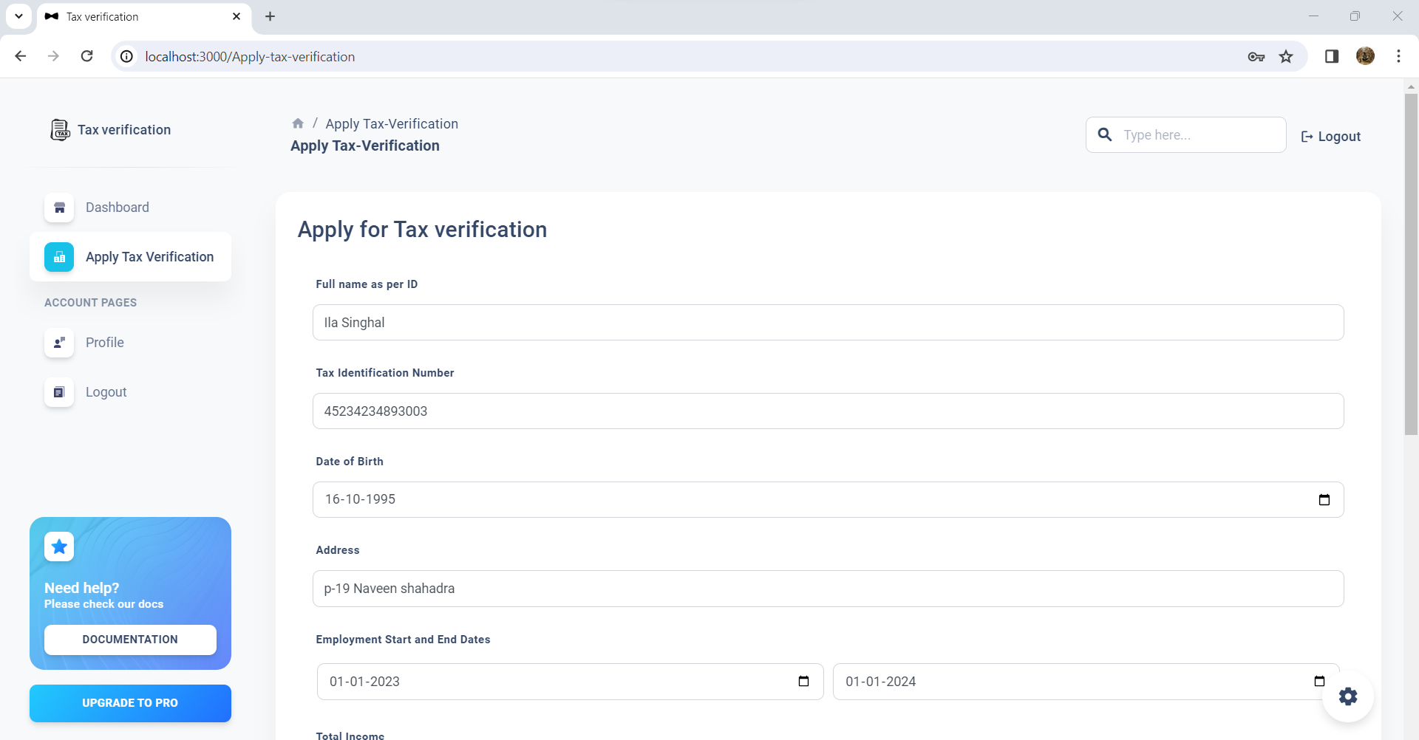
APPLY TAX VERIFICATION

Slide 8
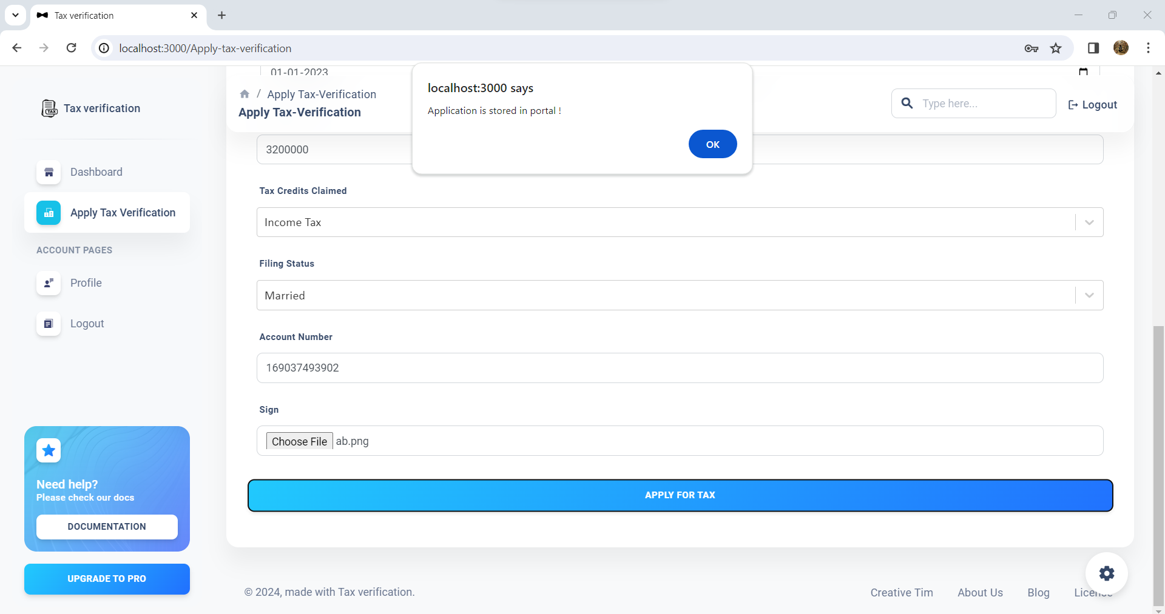
USER APPLIED FOR TAX

Slide 9
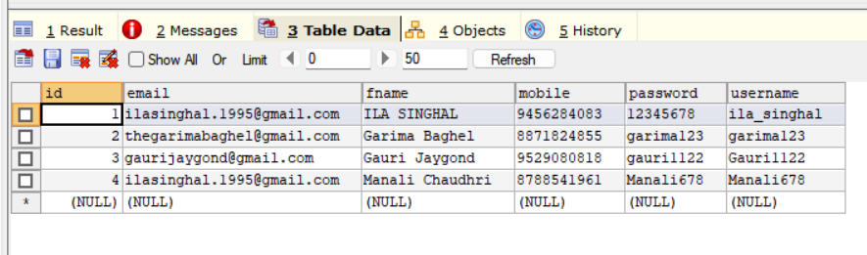
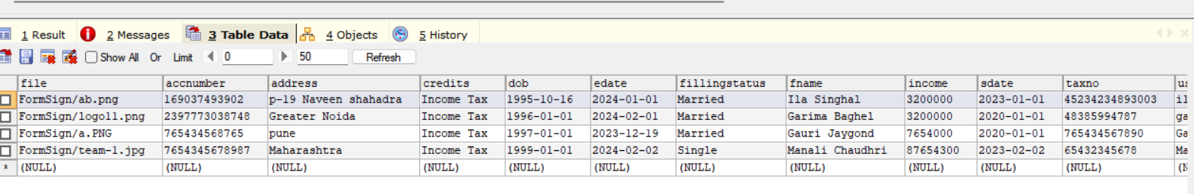
DATABASE

Slide 10
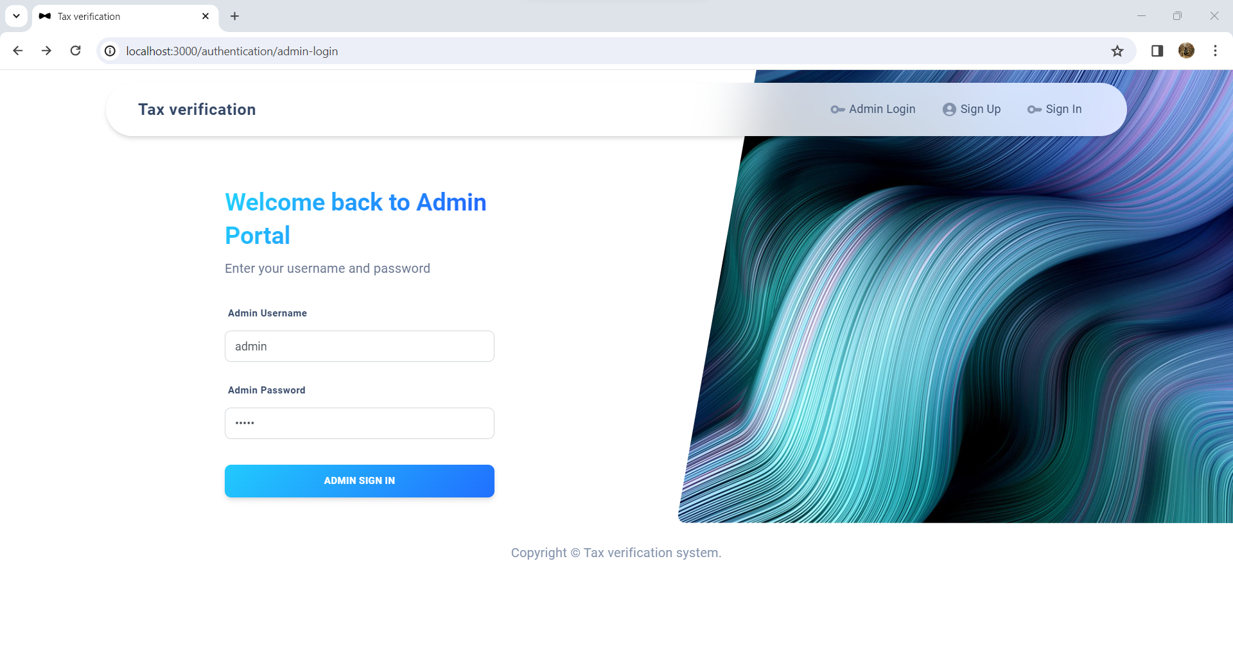
ADMIN LOGIN PAGE

Slide 11
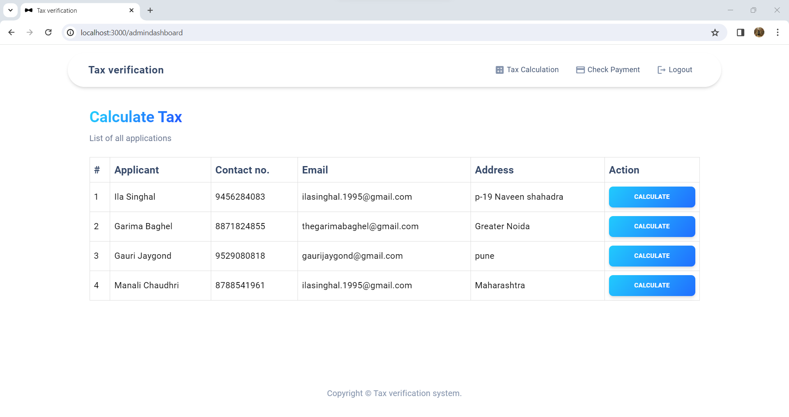
TAX PAYER INFO AT ADMIN LAYOUT

Slide 12
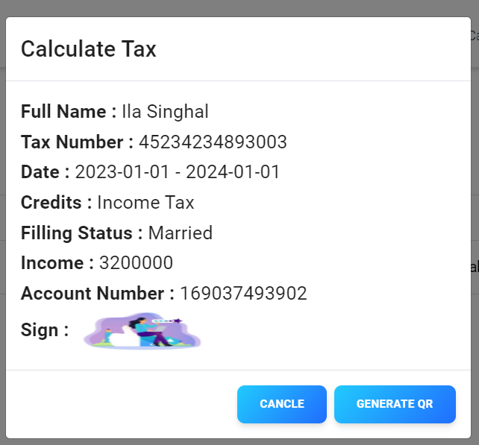
QR GENERATION/ADMIN LAYOUT

Slide 13

Overview of the QR code technology
What is a QR code: QR code, short for Quick Response code, is a two-dimensional barcode that can store a variety of data such as URLs, text, or other information.
How it works: QR codes can be scanned using a smartphone camera or QR code scanning app, allowing users to quickly access the embedded information.
Applications: QR codes are widely used for contactless payments, ticketing, product packaging, and even for providing additional information through print media.

Slide 14
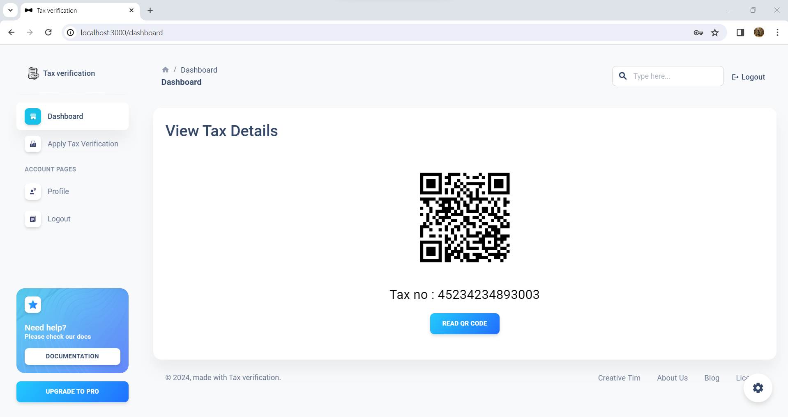
GENERATED QR CODE

Slide 15
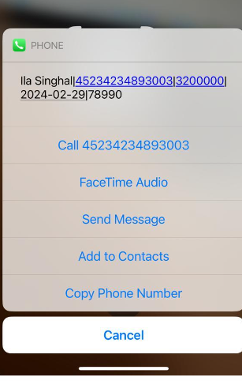
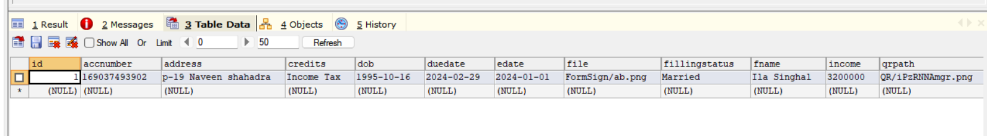
QR CODE SCAN INFO
Salary
User Name
Account Number
Tax Amount
Due Date

Slide 16

How the TVS simplifies tax payment processes
1
Efficient Tax Data Collection
The Tax Verification System (TVS) simplifies tax payment processes by efficiently collecting tax data from businesses and individuals. Through the incorporation of QR codes, taxpayers can easily generate and submit their tax information, eliminating the need for manual data entry and reducing the likelihood of errors.
2
Streamlined Verification Process
Once the tax data is submitted through the TVS, the system streamlines the verification process by automatically validating the information against tax regulations and requirements. This reduces the time and resources required for manual verification, enabling faster processing of tax payments.
3
Real-time Payment Tracking
With the TVS, taxpayers can track their tax payments in real-time, providing transparency and visibility into the status of their payments. This feature reduces the need for follow-up inquiries and enhances trust in the tax payment process, ultimately simplifying the overall tax payment experience for users.

Slide 17
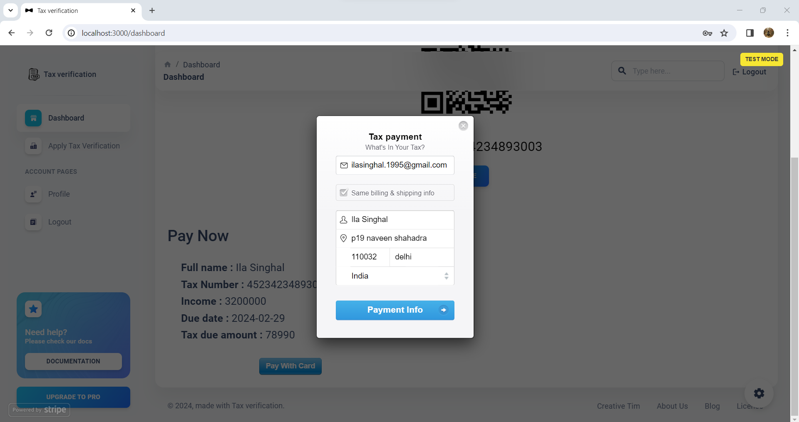
CARD PAYMENT (STRIPE API)

Slide 18
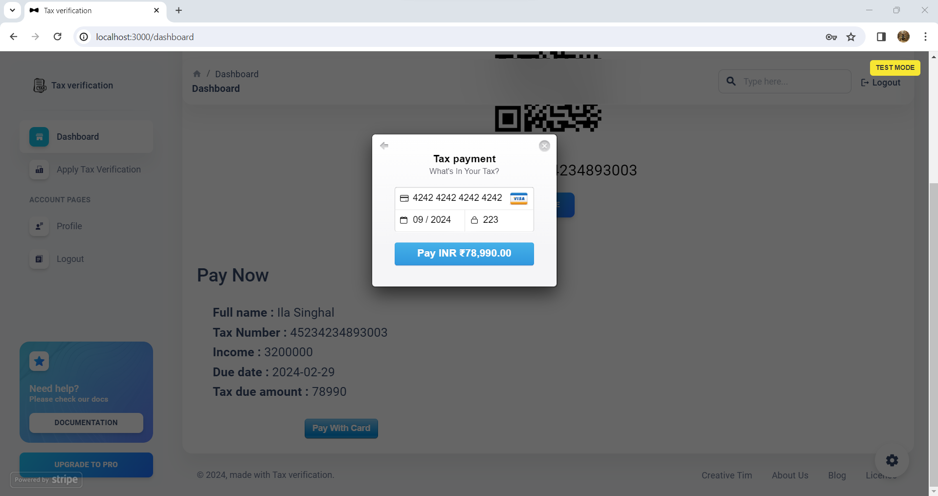
PAYMENT LAYOUT

Slide 19
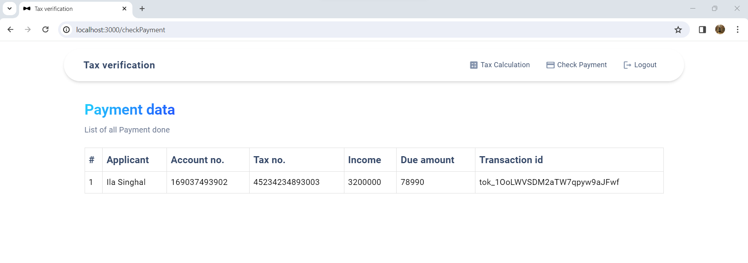
GENERATED TRANSACTION ID

Slide 20
Key features and functionalities of the TVS
Enhanced Security Measures
Real-time Verification
Integration with Payment option
One of the key features of the TVS is its ability to provide real-time verification of tax payment status. Taxpayers can instantly verify the authenticity of tax payments by scanning the QR code, reducing the risk of fraud and errors.
The TVS incorporates advanced encryption and authentication protocols to ensure the integrity of tax data and the security of transactions. It utilizes secure QR code technology to prevent unauthorized access and protect sensitive taxpayer information.
The TVS seamlessly integrates with payment platforms, allowing taxpayers to make secure and convenient tax payments. This streamlines the payment process and enhances user experience.

Slide 21



Integration of the TVS with existing tax systems
Data Integration
Collaborative Functionality
Seamless Interaction
The TVS seamlessly integrates with existing tax systems by enabling secure data exchange and synchronization. This ensures that the information flow between different tax platforms remains consistent and accurate, allowing for efficient processing and verification of tax payments.
With the TVS, tax authorities can collaborate with other government agencies and financial institutions to streamline tax verification processes. This collaborative approach enhances transparency and reduces the chances of errors or discrepancies in tax payments.
The TVS ensures seamless interaction with existing tax systems, providing a user-friendly experience for both taxpayers and tax authorities. This enables the smooth transfer of tax payment data and enhances the overall efficiency of the tax verification process.

Slide 22
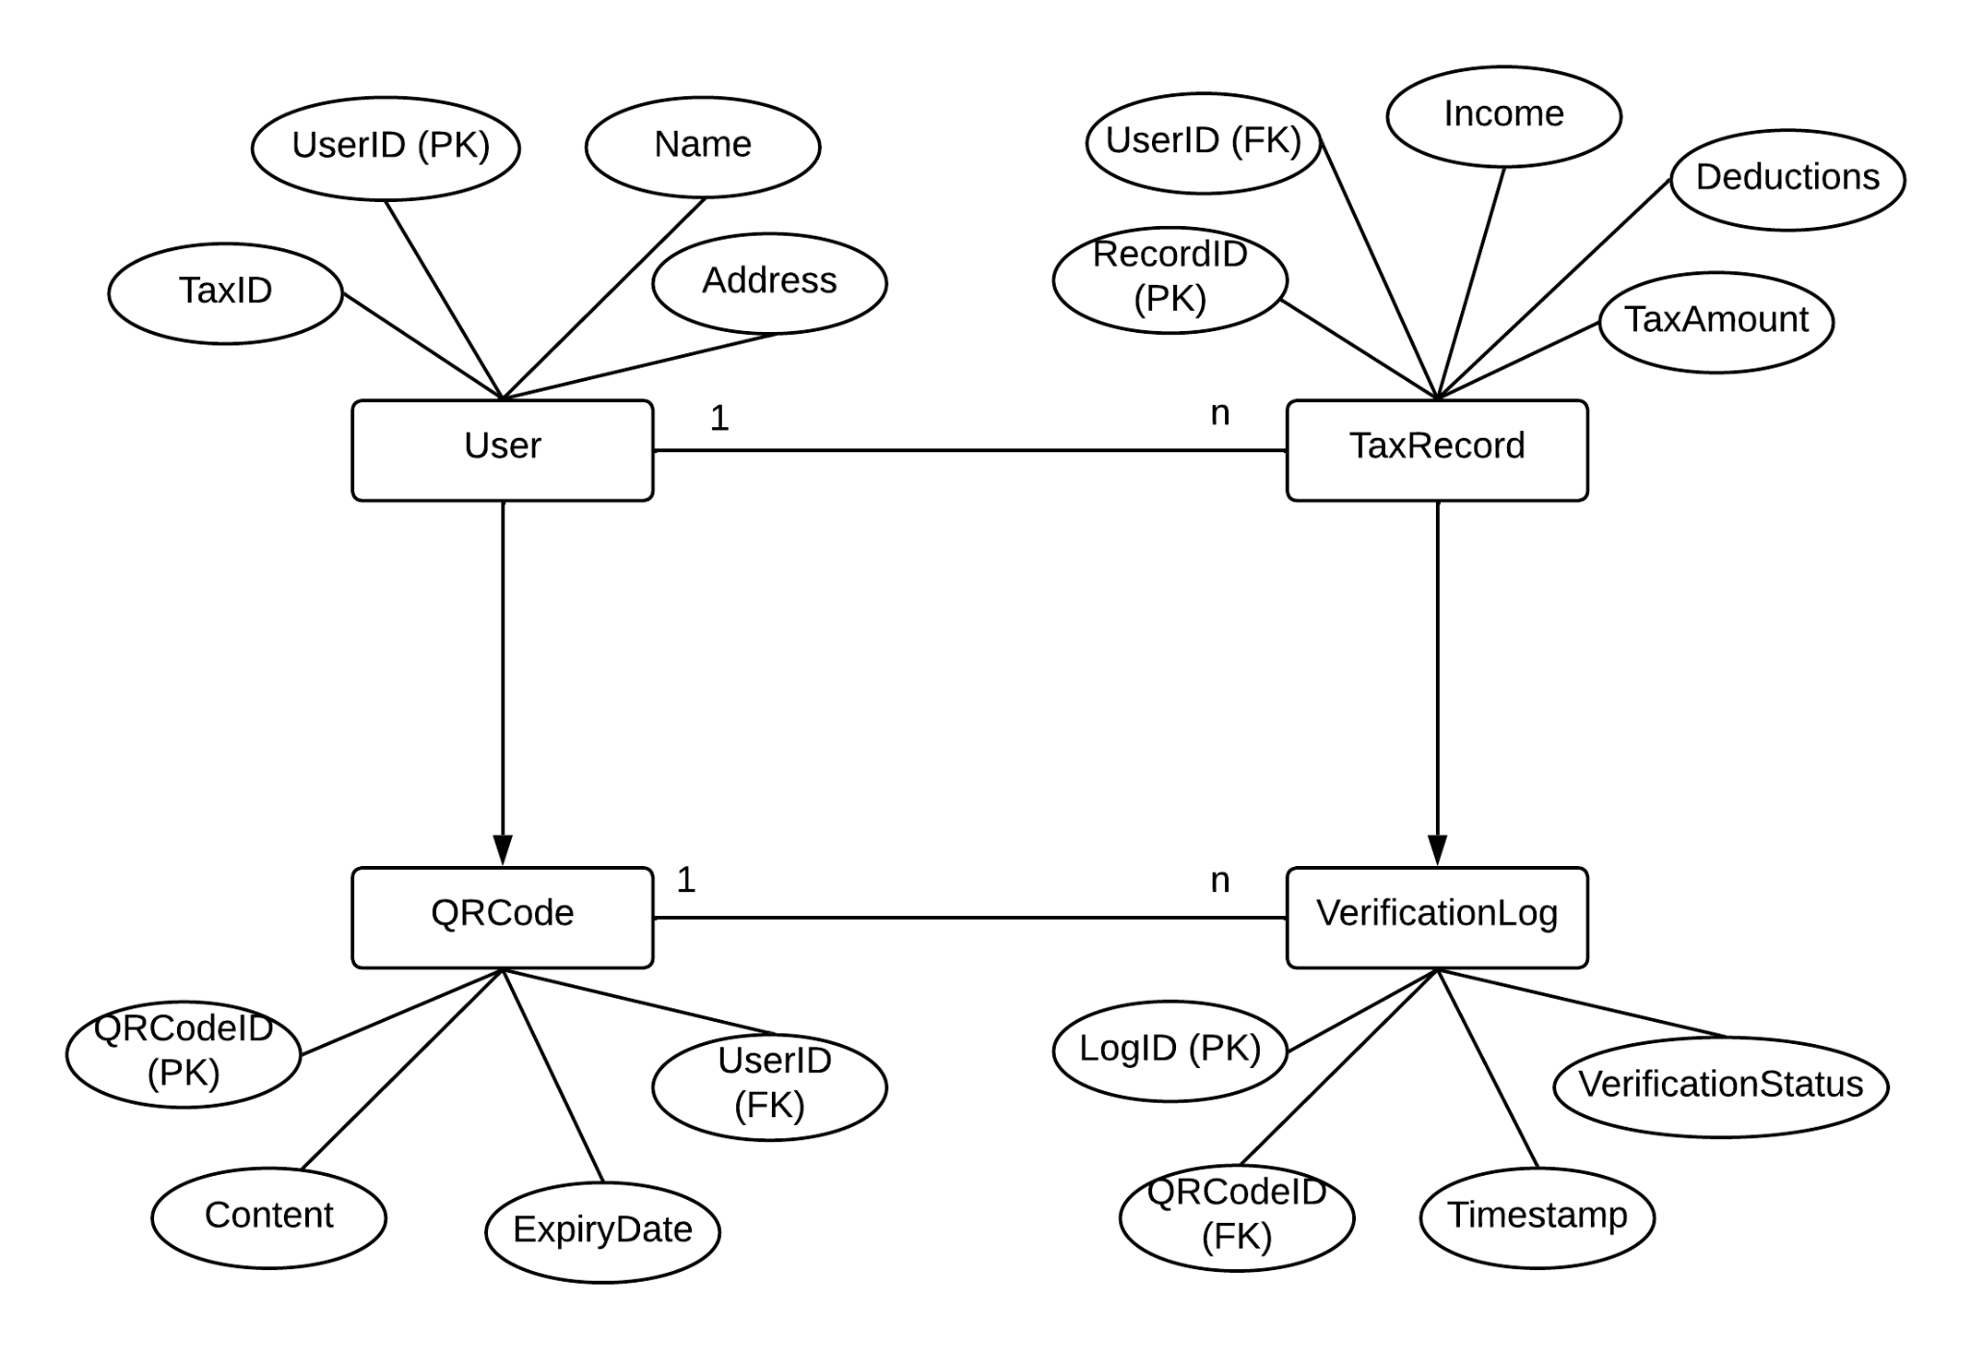
ER diagram

Slide 23
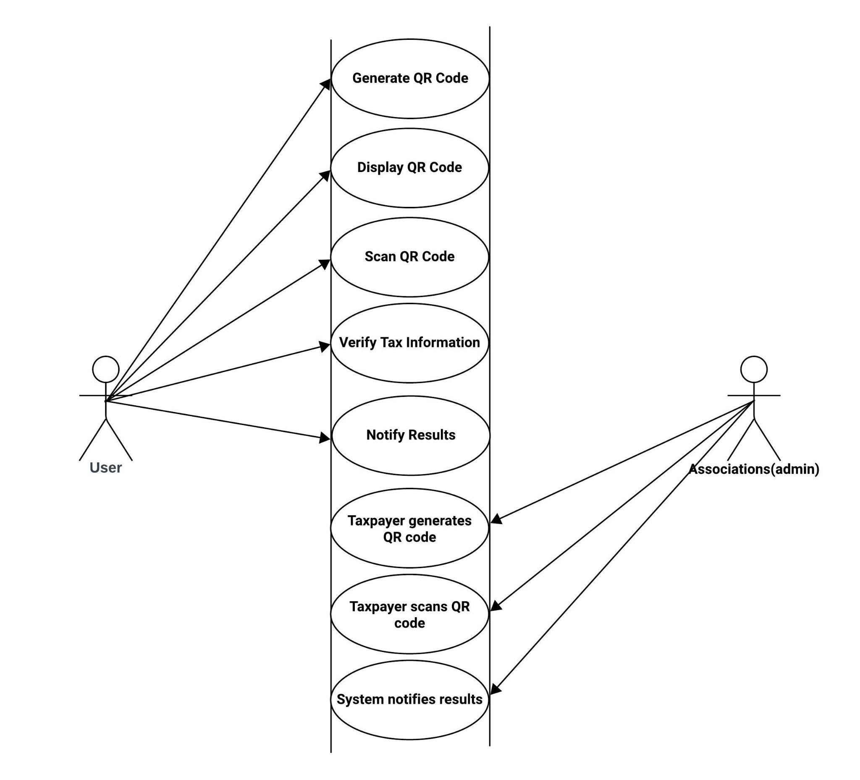
USE CASE diagram

Slide 24
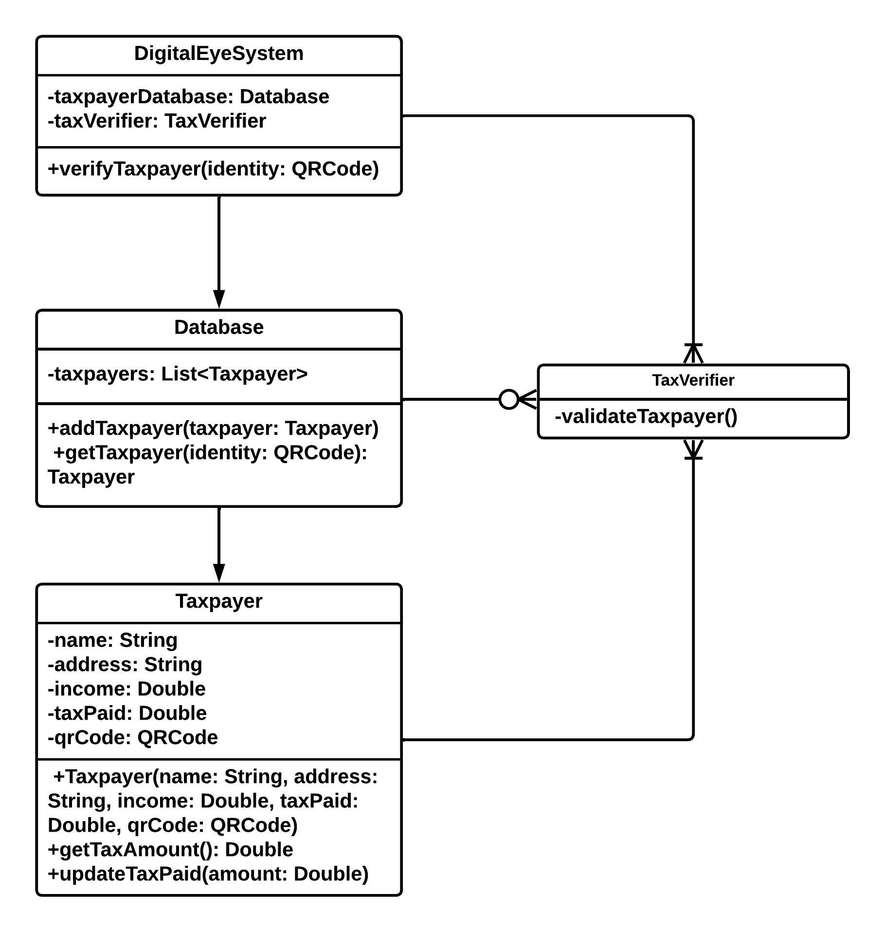
CLASS DIAGRAM

Slide 25
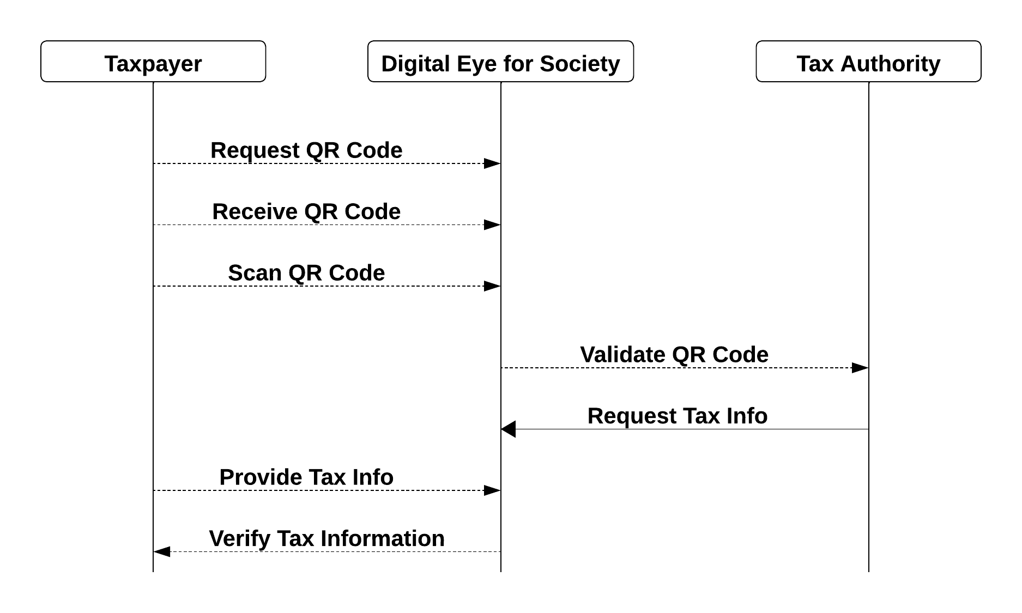
SEQUENCE DIAGRAM

Slide 26
Conclusion
In conclusion, the proposed Property Tax Verification and Payment System utilizing React and Spring Boot presents a forward-looking solution to the challenges inherent in traditional property tax management processes.
By addressing issues related to manual procedures, lack of transparency, and outdated technology, the system aims to bring efficiency, security, and user satisfaction to the forefront.
The seamless integration of React and Spring Boot not only ensures a modern and responsive user interface but also provides a robust and scalable backend infrastructure.
The future of this system lies in its ability to adapt to technological advancements and user expectations. With continuous enhancements, the Property Tax Verification and Payment System is poised to become a dynamic and indispensable tool for property owners and tax authorities alike.
This system not only streamlines existing processes but lays the foundation for a proactive and technologically advanced approach to property tax management in the years to come.

Slide 27
User Experience and Ease of Use in the Tax Verification System (TVS)
1
Intuitive Interface
2
Seamless Navigation
The TVS boasts an intuitive and user-friendly interface, ensuring that both individual taxpayers and businesses can easily navigate through the system. The design prioritizes simplicity and clarity, minimizing the learning curve for users.
Users can effortlessly move between different sections of the TVS, making the process of verifying tax payments and information retrieval smooth and efficient. The navigation system is designed to minimize the number of steps required to complete tasks.
3
Clear Instructions
4
Accessible Support
Clear and concise instructions are provided at each step, ensuring that users know exactly what actions to take and what information is required. This helps to reduce errors and misunderstandings during the tax verification process.
The TVS offers accessible support channels, including live chat, FAQs, and detailed user guides, to assist users in resolving any queries or issues they may encounter. This ensures a smooth and hassle-free experience for all users.

Slide 28


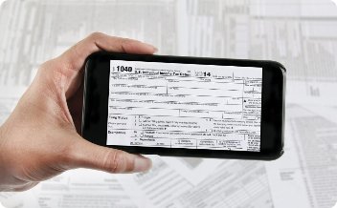
Future developments and enhancements for the TVS
Next-Generation QR Code Integration
Blockchain Integration for Transparent Transactions
Mobile Application for Seamless User Experience
In the future, the Tax Verification System (TVS) is poised to integrate advanced QR code technology that boasts enhanced security features and expanded data capacity. This next-generation QR code will allow for more comprehensive tax verification processes and improved efficiency in transactions.
With future developments, the TVS will incorporate blockchain technology to ensure transparent and secure tax transactions. By leveraging blockchain, the system will provide a tamper-proof record of tax payments, enhancing trust and accountability in the tax verification process.
The TVS will introduce a dedicated mobile application that allows taxpayers to conveniently verify and process tax payments on the go. This app will offer a user-friendly interface, real-time notifications, and personalized tax insights, revolutionizing the way individuals interact with the tax system.

